Slide 1
Introduction to Cryptography

Slide 2
cryptology
cryptography
cryptanalysis
Encryption
Decryption
Encryption: Converting plaintext to ciphertext using
an encryption key “E”.
Decryption: recovering the plaintext from the ciphertext
using a decryption key “D”.
Plaintext: Text before encryption (original text) “P”.
Ciphertext: Text after encryption (coded text) “C”.
Cryptanalysis: Trying to recover the plaintext
without knowing the key

Slide 3
Encryption Function E( ), Encryption key=K1
E_{K1}( )
C= E_{K1}( P ),
also written as E (K1,P)
P
C
Decryption Function D( ), Decryption key=K2
D_{K2}( C )
also written as D(K2,C)
C
D_{K2}( )
P
The E( ) and D( ) functions may be different,
but may also be the same function

Slide 4
Classification of cryptographic algorithms
Cryptographic Algorithms
Modern
deals with binary
Representation of
Data
Classical
deals with data as
a string of characters
Symmetric
If K1=K2
Asymmetric
If K1 != K2
Also called
Public key
algorithms
One way Hashing
Algorithms
No key is needed

Slide 5
Approaches for symmetric classical encryption
1- Substitution
  Monoalphabetic : substitute a character for another character according to some mapping relation, (e.g. Caesar cipher).
  Polyalphabetic: use different characters to substitute for one character according to a specified scheme (e.g. vigenere tableau)
  Multi-character substitution: e.g. substitute a pair of characters for another pair of characters, (e.g. playfair cipher, Hill cipher)

Slide 6
Approaches for symmetric classical encryption
2- Transposition (character permutation)
interchanging character positions within the character string without changing their values, (e.g. columnar transposition cipher).
3- Product Ciphers:
Using several stages of encryption with different algorithm for every stage to produce a cipher which is more difficult to cryptanalyze,

Slide 7
Product Cipher
P
E_{K1}( )
E_{K2}( )
C
C= E_{K}(P)= E_{K1}(E_{K2}(P))
Where K={K₁ , K₂}
Usually K₁ and K₂ are derived from K
using some function: i.e.
K₁ = f₁ (K)
and
K₂ = f₂ (K)

Slide 8
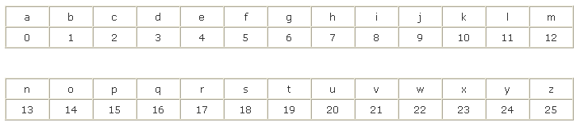
Caesar Cipher
Given by the monoalphabetic substitution:
C = E(k, p) = (p + k) mod 26
P = D(k, c) = (c – k) mod (26)
Where characters from a to z are assigned numerical values from 0 to 25, i.e.

Slide 9
Example on caesar cipher
With k=3, substitution is as follows:
plain: a b c d e f g h i j k l m n o p q r s t u v w x y z
cipher: D E F G H I J K L M N O P Q R S T U V W X Y Z A B C
plain: meet me after the class
cipher: PHHW PH DIWHU WKH FODVV

